Slide 1
Management 515
Promoting Effective Communication
© 2014, 2016 David E. Frick.
All rights reserved.

Slide 2
Definitions
Communication. The sharing of information between two or more individuals or groups to reach a common understanding
Verbal. The encoding of messages into words, either written or spoken
Nonverbal. The encoding of messages by means of facial expressions, body language, styles of dress, gestures, vocal intonations, and other means
Notes:
Verbal communication is the sharing of information between individuals by using speech or the written word. In business, individuals need to effectively use verbal communication that employs readily understood spoken words, and ensure that the enunciation, stress, and tone of voice with which the words are expressed is appropriate.
Nonverbal communication is the sending and receiving wordless cues. It includes the use of visual cues, such as body language, distance, physical appearance, voice, and touch.
Just as speech contains nonverbal elements (voice quality, rate, pitch, volume, speaking style, rhythm, intonation, and stress), written texts have nonverbal elements such as handwriting style, spatial arrangement of words, or the physical layout of a page.
Nonverbal communication involves the processes of encoding and decoding. Errors in interpretation of nonverbal cues can lead to miscommunication.
Culture plays an important role in nonverbal communication. In American communities an emphasis on nonverbal communication can exist, e.g., gang signs, obscene gestures.
In casual exchanges, nonverbal communication constitutes between 30 and 70 percent of the information exchanged.

Slide 3
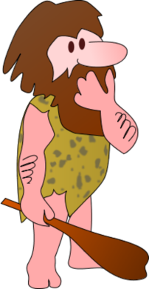
Communications Process
Message
Image
Image
Encoding
Transmission
Decoding
Decoding
Transmission
Encoding
Image
Image
Feedback
Notes:
Here is the basic communications model.
The sender creates an image in his mind, translates (encodes) that image into a medium believed to be understandable by the receiver, and transmits the encoded message.
The receiver captures the encoded message, then translates (decodes) it into an image his mind can understand.
The process starts over in the feedback loop.
Encoding can take the form of words, pictures, gestures, or other nonverbal cues. In the encoding process, language becomes vital. Variations in inflection, tone, or stress can completely confuse the message.

Slide 4

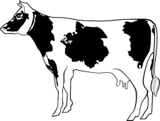


Communications Process
Message
Encoding
Transmission
Decoding
Decoding
Transmission
Encoding
Feedback
Notes:
In this case, the caveman on the right is thinking horse; however, the caveman on the left understands cow.
This could be a language (encoding/decoding) issue (both cavemen use the same word to mean two different things) or a transmission error (caveman two misunderstood what caveman one said).

Slide 5
Perception
Process through which people select, organize, and interpret sensory input to give meaning and order to the world around them
Influenced by people’s personalities, values, attitudes and moods as well as their experience and knowledge
Perception is reality!
Biases. Systematic tendencies to use information about others in ways that can result in inaccurate perceptions
Notes:
Perception can also have a strong affect on communication.
Look at eye witness testimony as an example. The bedrock of the American judicial process is the honesty of witnesses in trial. Eyewitness testimony can make a deep impression on a jury.
Several studies have been conducted on human memory and on subjects’ propensity to remember erroneously events and details that did not occur. Elizabeth Loftus performed experiments in the mid-seventies demonstrating the effect of a third party’s introducing false facts into memory. Subjects were shown a slide of a car at an intersection with either a yield sign or a stop sign. Experimenters asked participants questions, falsely introducing the term "stop sign" into the question instead of referring to the yield sign participants had actually seen. Similarly, experimenters falsely substituted the term "yield sign" in questions directed to participants who had actually seen the stop sign slide. The results indicated that subjects remembered seeing the false image. In the initial part of the experiment, subjects also viewed a slide showing a car accident. Some subjects were later asked how fast the cars were traveling when they "hit" each other, others were asked how fast the cars were traveling when they "smashed" into each other. Those subjects questioned using the word "smashed" were more likely to report having seen broken glass in the original slide. The introduction of false cues altered participants’ memories.
Adapted from The Problem with Eyewitness Testimony. http://agora.stanford.edu/sjls/Issue%20One/fisher&tversky.htm

Slide 6
Stereotypes
Simplified and often inaccurate beliefs about the characteristics of particular groups of people
Can interfere with the encoding and decoding of messages
Stereotypes can be damaging when used as the sole basis of decision
However, “the reason that stereotypes are often useful is that people tend to act stereotypically.”
--David E. Frick
Notes:
When managers and other members of an organization are ineffective communicators,
organizational performance suffers and any competitive advantage the organization might have is likely to be lost
Stereotypes can be hindrances to communications. Thinking that some class of people think in a specific way can be misleading. In fairness, some stereotypes are almost always accurate. For example, a poll conducted by The Pew Group concluded that 97 percent of all mainstream media reporters (those working for major newspapers and television stations) self identify as liberal and voted for Barrack Obama. So it is fair to assume that any article written in the mainstream media or on television is biased towards Barrack Obama?
I would suggest that 97 percent of the time, you would be right.

Slide 7
How to Be Effective Communicators
Select the appropriate medium for each message—there is no one “best” medium
Consider information richness. A medium with high richness can carry much more information to aid understanding
Use “Active Listening”
Notes:
No “one best” medium of communication exists. The medium you should use is a function of the amount of information that needs to be conveyed, the ability of the receiver to consume the message, and time sensitive.
Almost always, verbal, face-to-face communication is best for non-complex communication, but sometimes, it is not.
For example, the Presidents of the United States and Russia can communicate directly with each other through a system called the Washington-Moscow Direct Communications Link. Fifty yours ago, this was a teletype system. Over the years, it has been upgraded to a text file and now an email system. For many decades, the Russians have asked that the system be upgraded to full motion video. The technology exists to keep such a link secure and in real time. The United States has always balked at the recommendation. Why? We understand that full motion video, in a crisis situation, might convey information we did not want to reveal—remember nonverbal communication? What would a bit of perspiration on the lip of a U.S. president tell the Russians?

Slide 8
Active Listening
Active listening is a communication technique used in counseling, training and conflict resolution, which requires the listener to feed back what they hear to the speaker, by way of re-stating or paraphrasing what they have heard in their own words, to confirm what they have heard and moreover, to confirm the understanding of both parties (Wikipedia).
It is a skill that can be developed with practice.
20-20-20-40
Notes:
Active listening involves the listener observing the speaker's behavior and body language. Having the ability to interpret a person's body language lets the listener develop a more accurate understanding of the speaker's message. Having heard, the listener then paraphrases and repeats the speaker's words. The listener is not necessarily agreeing with the speaker, but simply stating what was heard and observed.
Individuals in conflict often contradict each other. Ambushing occurs when one listens to someone else's argument for its weaknesses and ignore its strengths. This may include a distortion of the speaker’s argument to gain a competitive advantage. On the other hand, if one finds that the other party understands, an atmosphere of cooperation can be created.
Active listening is not complex. Listeners need only restate, in their own language, their impression of the expression of the sender. However, Active Listening is a rather difficult task to master.
See: https://www.mindtools.com/CommSkll/ActiveListening.htm
See: https://www.youtube.com/watch?v=lL0sDXCzRu0
In any conversation before a group:
20% are listening to what you are saying
20% are forming a counter argument to what you are saying
20% are forming grocery lists or other task lists
40% are having amorous thoughts

Slide 9
Active Listening
Advocacy Opening Lines |  | Inquiry Opening Lines
1. State your view | I think that we should do … | 1. Ask about other’s view or data | How do you see it differently?
2. Provide the data or which it is based | The data I base that on is … | 2. Probe other’s reasoning behind their view | What leads you to that conclusion
3. Explain how you got from that data to your conclusions | I reasoned that … | 3. Invite challenge to your understanding of their view | My understanding of your view is … What have I missed?
4. Encourage critique and questioning of your view | What is your reaction?

Slide 10
Information Richness
The amount of information that a communication medium can carry
The extent to which the medium enables the sender and receiver to reach a common understanding

Slide 11


Richness of Communications
Low
high
Memos
Articles
Posters
Broadcast email
Personal letters
Personal emails
Telephone calls
VTC
Skype
Sametime
Face-to-face
Notes:
Richness flows from left to right.
As stated earlier, face-to-face is almost always best.
View this video: https://www.youtube.com/watch?v=DYu_bGbZiiQ (conference call)
For subjects that are highly complex, written communications may be necessary to augment understanding.

Slide 12
Forms of Communication
Face-to-Face. Has highest information richness. Can take advantage of verbal and nonverbal signals.
Management by wandering around. Face-to-face communication technique in which a manager walks around a work area and talks informally with employees about issues and concerns.
Spoken Communication Electronically Transmitted
Has the second highest information richness. Telephone conversations are information rich with tone of voice, sender’s emphasis, and quick feedback, but provide no visual nonverbal cues.
Notes:
Face-to-Face
Provides for instant feedback.
Management by wandering around takes advantage of this with informal talks to workers.
Video conferences provide much of this richness and reduce travel costs and meeting times.

Slide 13
Forms of Communication
Personally Addressed Written Communication
Has a lower richness than the verbal forms of communication, but still is directed at a given person. Personal addressing helps ensure receiver actually reads the message—personal letters and e-mail are common forms
Impersonal Written Communication
Has the lowest information richness. Good for messages to many receivers where little or feedback is expected, e.g., newsletters, reports
The potential for important information to be ignored or overlooked while tangential information receives attention
Notes:
Personally Addressed Written Communication
--Does not provide instant feedback to the sender although sender may get feedback later.
--Is an excellent medium for complex messages requesting follow-up actions by receiver.
Email do’s and don’ts
--E-mail allows telecommuting employees to work from home and keep in contact.
The use of e-mail is growing rapidly and e-mail etiquette is expected:
--Typing messages in all CAPITALS is seen as “screaming” at the receiver.
--Punctuate your messages for easy reading and don’t ramble on.
--Many managers do not have time to read all the electronic work-related information available to them. Be concise.
--Information overload is the potential for important information to be ignored or overlooked and can result in lost productivity

Slide 14


The Seven Learning Styles
Visual
Aural
Logical
Verbal
Social
Solitary
Physical
The Seven Learning Styles
Notes:
People learn in the seven different ways depicted above.
We all, also, have a preferred style. As an example, I am a visual learner. If you had data to convey to me, a pie chart would be more effective than a table of numbers.
As the sender, strive to discover the preferred style of you audience and adapt your message accordingly.
Over half of all people are visual learners.
What is your preferred learning style? http://www.personal.psu.edu/bxb11/LSI/LSI.htm

Slide 15
Points to Ponder
Sharing Information is Not Communicating..
The single biggest problem in communication is the illusion that it has taken place.
--George Bernard Shaw
What we have here is, failure to communicate.
--Captain, Road Prison 36, “Cool Hand Luke”
Never use email for ideas that are complex, controversial, or confidential.
I made a deliberate decision not to ask the President, so that I could insulate him from the decision and provide some future deniability for the President if it ever leaked out.
--VADM John Poindexter
Notes:
On this and the next few slides are some points that I would like you to consider.

Slide 16
Points to Ponder
Communicate to all at the same time and equally.
Nothing is swifter than rumor.
--Horace
A lie can travel halfway around the world while the truth is still putting on its shoes.
--Mark Twain
A good leader shares bad news with his team
Bad news isn’t wine. It doesn’t improve with age.
--Colin Powell

Slide 17
Points to Ponder
Understand before understanding
The most important thing in communication is to hear what is not being said.
--Peter F. Drucker
Complex words make complex communication
Simplicity is the ultimate sophistication.
--Leonardo da Vinci
Brevity is the soul of wit.
--Shakespeare

Slide 18
Organizational Communications
Organization Chart.
Summarizes the formal reporting channels in an organization
Communication in an organization flows through formal and informal pathways
Vertical communications flow up and down the corporate hierarchy
Grapevine. An informal network carrying unofficial information throughout the firm
Notes:
Organizational communication, as a field, is the consideration, analysis, and criticism of the role of communication in organizational contexts.
Its main function is to inform, persuade, and promote goodwill. The flow of communication could be either formal or informal.
Communication flowing through formal channel's are downward, horizontal, and upward along establish communication paths.
Informal channels are generally termed the grapevine.

Slide 19
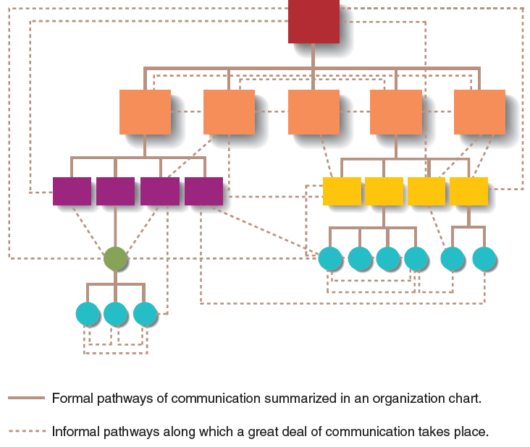
Formal and Informal Networks
Notes:
Here is a visual.

Slide 20
IT and Communication
Intranets. A company-wide system of computer networks for information sharing by employees inside the firm.
Versatile as a communication medium
Can be used for many purposes by people who may have little expertise in computer software and programming
Groupware. Computer software that enables employees to share information with each other to improve communication and performance. Employees are likely to resist using groupware when people are working primarily on their own, rewarded for their own individual performances, reluctant to share information

Slide 21
Barriers to Effective Communication
Messages are:
unclear, incomplete, difficult to understand
sent over an inappropriate medium
received but ignored
not structured to provide or accommodate feedback
misunderstood
Jargon.
specialized language that members of an occupation, group, or organization develop to facilitate communication among themselves
should never be used when communicating with people outside the occupation, group, or organization
Notes:
Organizations create a protective vocabulary (jargon) for many purposes:
--to differentiate it from competitors
--to isolate non-members (outsiders)
--to speed communications, e.g., use of acronyms
--as a bonding mechanism, i.e., proving you are an insider
Jargon may serve an organizational purpose, but you must be aware of your interaction with outsiders.
View the video: https://www.youtube.com/watch?v=BKorP55Aqvg (The Expert)

Slide 22
Barriers to Effective Communication
Filtering. Withholding part of a message because of the mistaken belief that the receiver does not need or will not want the information
Information Distortion. Changes in the meaning of a message as the message passes through a series of senders and receivers
Notes:
Filtering can be disastrous for and organization. Bad news never gets better with age. Filtering out bad or uncomfortable information puts decision makers in a position to make the wrong decision.
In 2012 a volunteer working on International Games Day ran a global game of Gossip that was played within multiple libraries around the world, with the current version of the phrase being passed from library to library across time zones. Over 26 hours, the inaugural game travelled through seven languages starting in St. Kilda Library, Melbourne, Australia as "Life must be lived as play" (a common paraphrase of a quote from Plato), and ending in Homer, Alaska, USA as "He bites snails." The second game, in 2013, started as "Play is training for the unexpected", and split into three different forks on the day and one of the libraries spread the game into local schools over the following week, for a total of five endings from that single start: "I love the world", "Zombie", "Clouds travel around the world", "Glow, glow, peanut butter jelly", and "Ian needs help".
http://globalgossipgame.com/2013/11/26/global-gossip-game-2013-final-results/

Slide 23
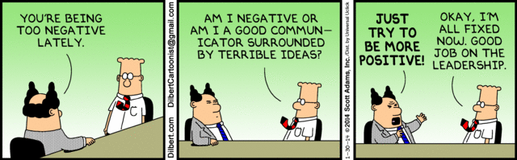
Final Thought

